Slide 1











SMART INDIA HACKATHON 2026
SMART INDIA HACKATHON 2026
ADVANTE
IDEA SUBMISSION
SMART
INDIA HACKATHON 2026
PROBLEM STATEMENT ID
26013
PROBLEM STATEMENT TITLE
Automated Integration and Intelligent Harmonization of Multi-source Geospatial Data for Urban Land Record Management
THEME
Smart Automation
PS CATEGORY
Software
Advante
TEAM NAME

Slide 2







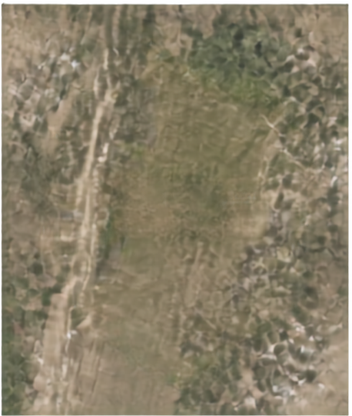
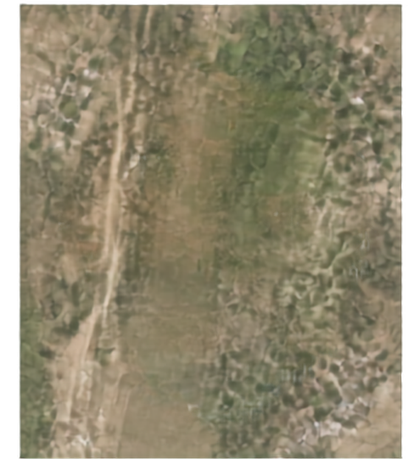







SMART INDIA HACKATHON 2026
SMART INDIA HACKATHON 2026
ADVANTE
IDEA SUBMISSION
Bhumi-Nakasha-
From Survey Number
to Intelligent Land Parcel
PROPOSED SOLUTION
TODAY
WITH BHUMI-NAKASHA
AI/GeoAI fuses cadastrad maps + textual land records
CV extracts survey boundaries from scanned sheets + drone imagery
Area-constrained ML splitss Survey No. 255 into 255/1, 255/2, 255/3
HOW IT ADDRESSES THE PROBLEM
255/1
Automates spatial matching, topology correction, conflict resolution
SURVEY NO. 255 (UNDIVIDED)
255/2
Integrates drone, ORI, DSM/DTM, GNSS, revenue, municipal, utility data
Removes manual GIS-technician bottlenecks in cadastral finalization
INNOVATION AND UNIQUENESS
255/3
India-specific fractional survey-number inference using ML + GNN
Human-in-loop confidence scoring, no auto legal boundary decisions
Natural-language GIS assistant for English/Hindi queries

Slide 3




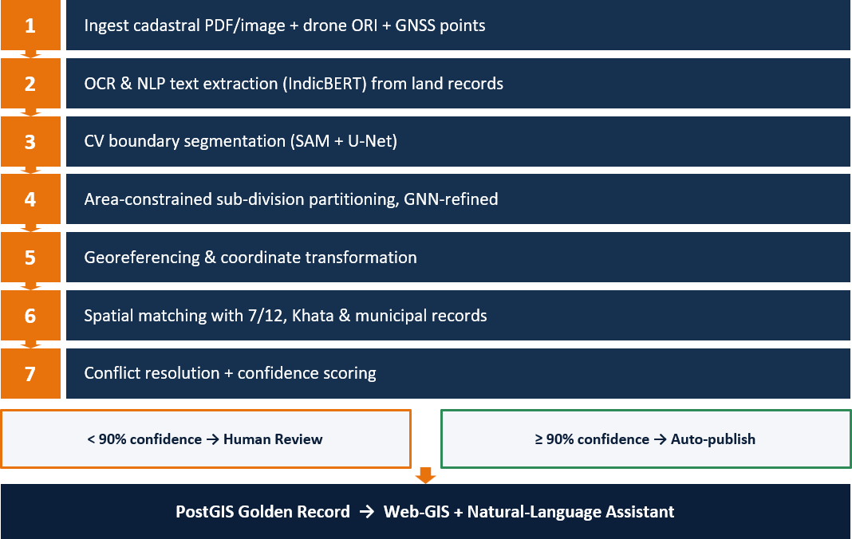

SMART INDIA HACKATHON 2026
SMART INDIA HACKATHON 2026
ADVANTE
IDEA SUBMISSION
TECHNICAL APPROACH
AI and GeoAI pipeline that harmonizes multi-source data into intelligent, trusted land parcels
AI / ML ENGINE
PyTorch
Segment Anything Model
U-Net
PyTorch Geometric (GNN)
Tesseracl/Cloud Vision OCR
IndicBERT
LLM + RAG
8
Locker/Kubernetes
AWS/Gol Cloud

Slide 4




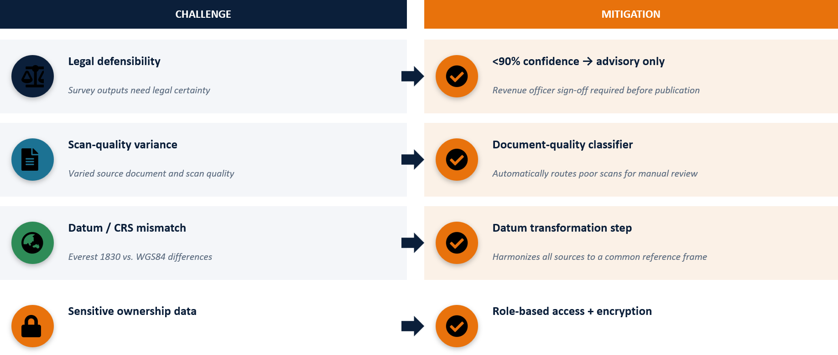
SMART INDIA HACKATHON 2026
SMART INDIA HACKATHON 2026
ADVANTE
IDEA SUBMISSION
Feasibility and Viability

Slide 5






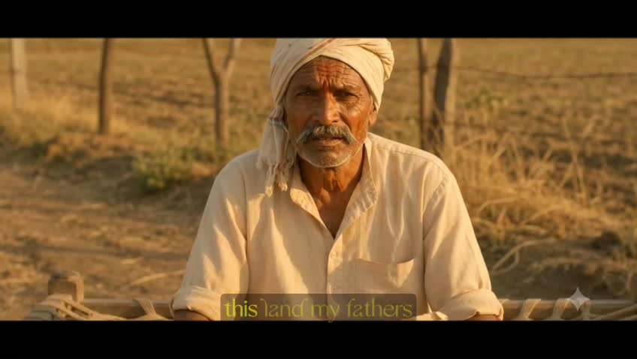








SMART INDIA HACKATHON 2026
SMART INDIA HACKATHON 2026
ADVANTE
IDEA SUBMISSION
SOCIAL
ECONOMIC
fewer disputes, transparency
faster loans, reduced legal costs
IMPACT THAT MATTERS
GOVERNANCE
ENVIRONMENTAL / PLANNING
versioned golden record, interoperability
accurate land-use, infrastructure planning
INTELLIGENT PARCELS. ACCURATE RECORDS. EMPOWERING INDIA.

Slide 6























SMART INDIA HACKATHON 2026
SMART INDIA HACKATHON 2026
ADVANTE
IDEA SUBMISSION
Ministry of Rural Development / DoLR – SIH Problem Statement 26013
NAKSHA programme (National Geospatial Knowledge-based Land Survey)
Research and
SVAMITVA Scheme, Ministry of Panchayati Raj
Maharashtra Bhumi Abholekh / Mahabhulekh portal (bhulekh.mahabhumi.gov.in)
References
Pilot: Plot Report, Village Khedi, Taluka Narkhed, District Nagpur (Survey No. 255)
Segment Anything Model paper
PostGIS documentation
PyTorch Geometric documentation
INTELLIGENT PARCELS. ACCURATE RECORDS. EMPOWERING INDIA.

